Slide 1
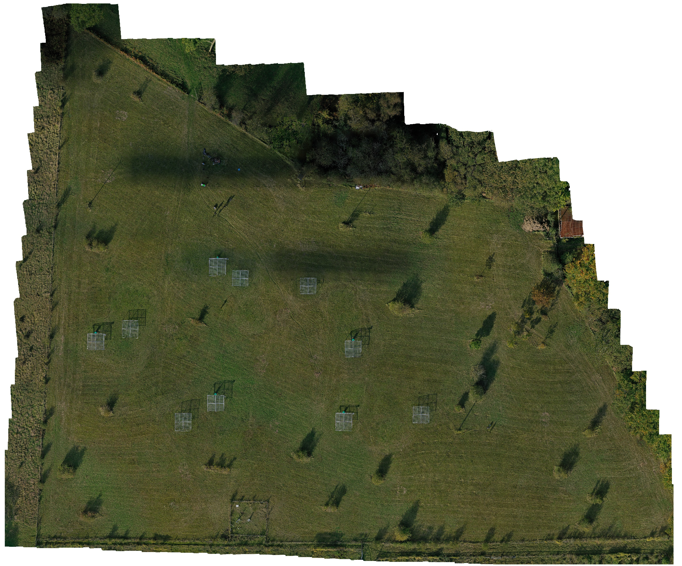
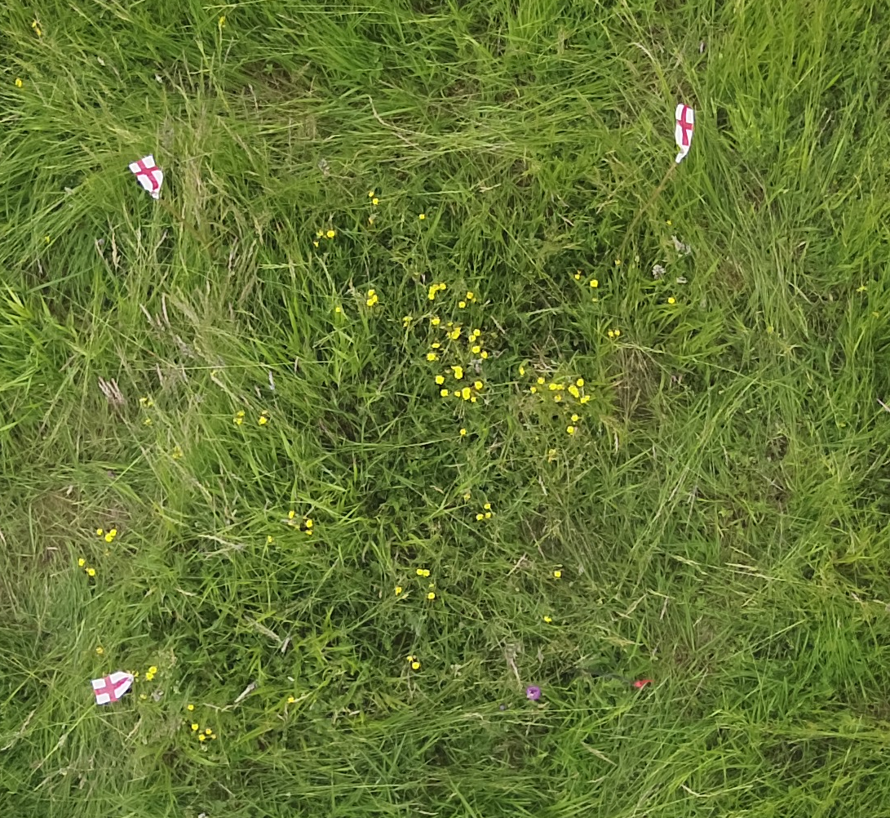
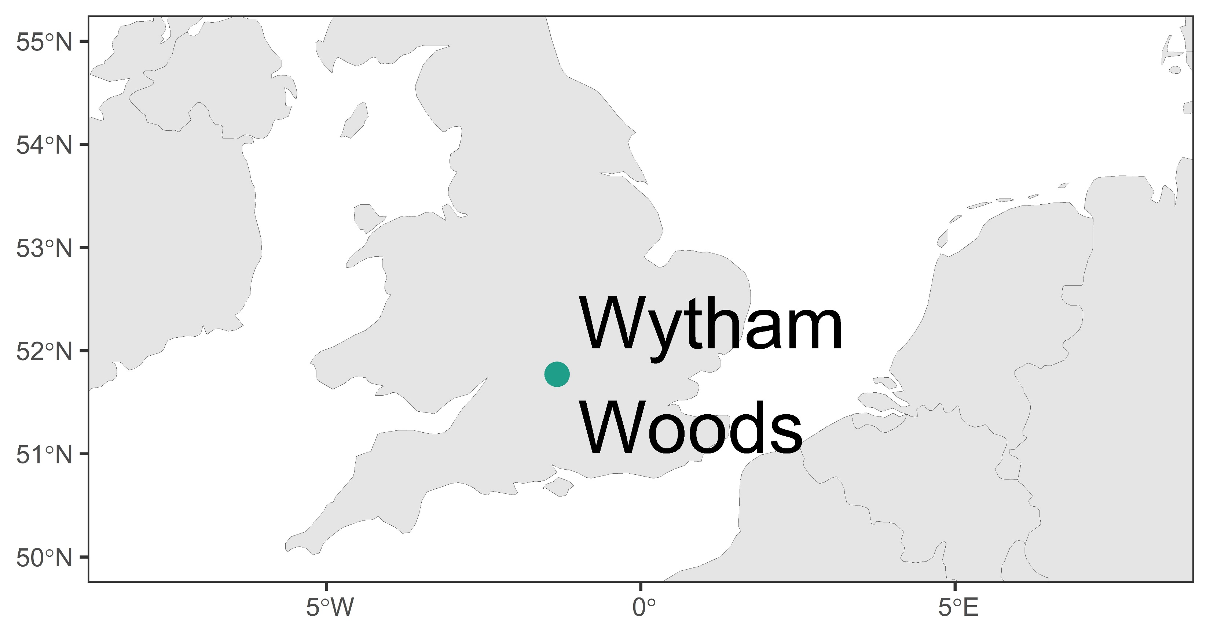
a) 5 m x 5 m experimental plots:
Ambient control
Procedural control
Drought
Irrigated
b) 1 m x 1 m observation quadrats:
*
1 m
40 m
* Denotes reference flag for image alignment.

